Slide 1
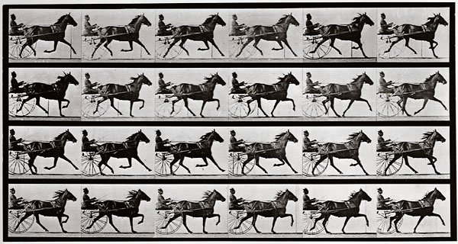
The Great Epizootic of 1872
Equine Influenza Devastates America

Slide 2
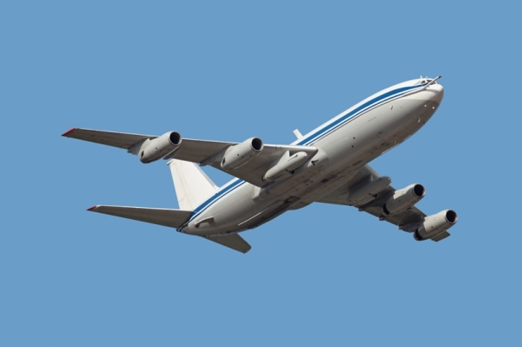
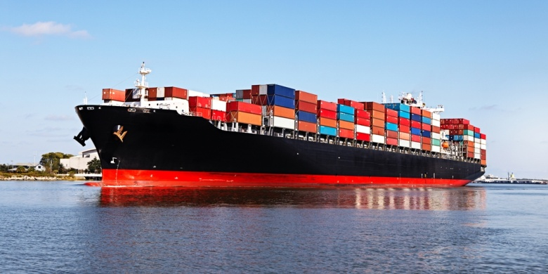
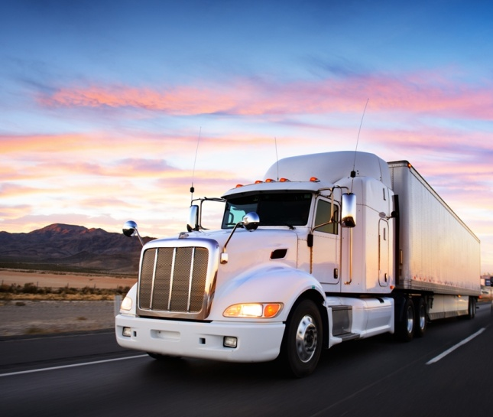
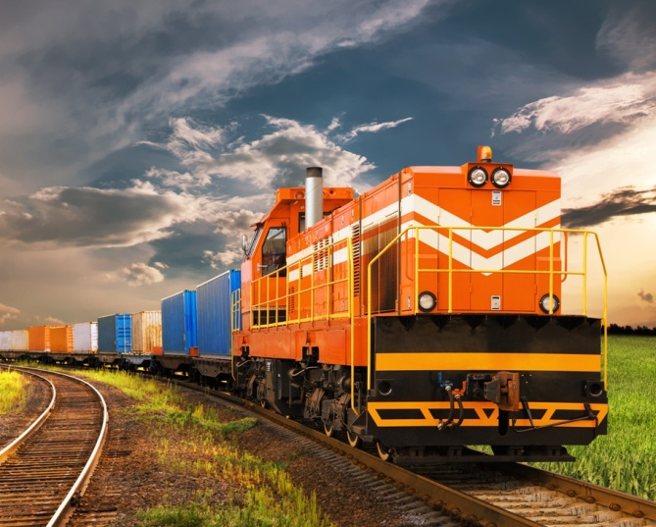
America Comes to a Halt
We see these forms of transportation every day and seldom stop to think of the integral role they play. What if our “workhorses” were suddenly unavailable?

Slide 3
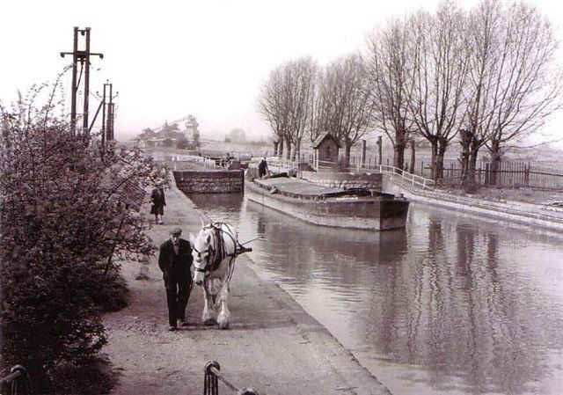
America Ran on Horse Power
Throughout most of U.S. history, the horse was the engine of business and commerce. Our nation relied on that gentle animal to move freight and perform countless tasks.

Slide 5
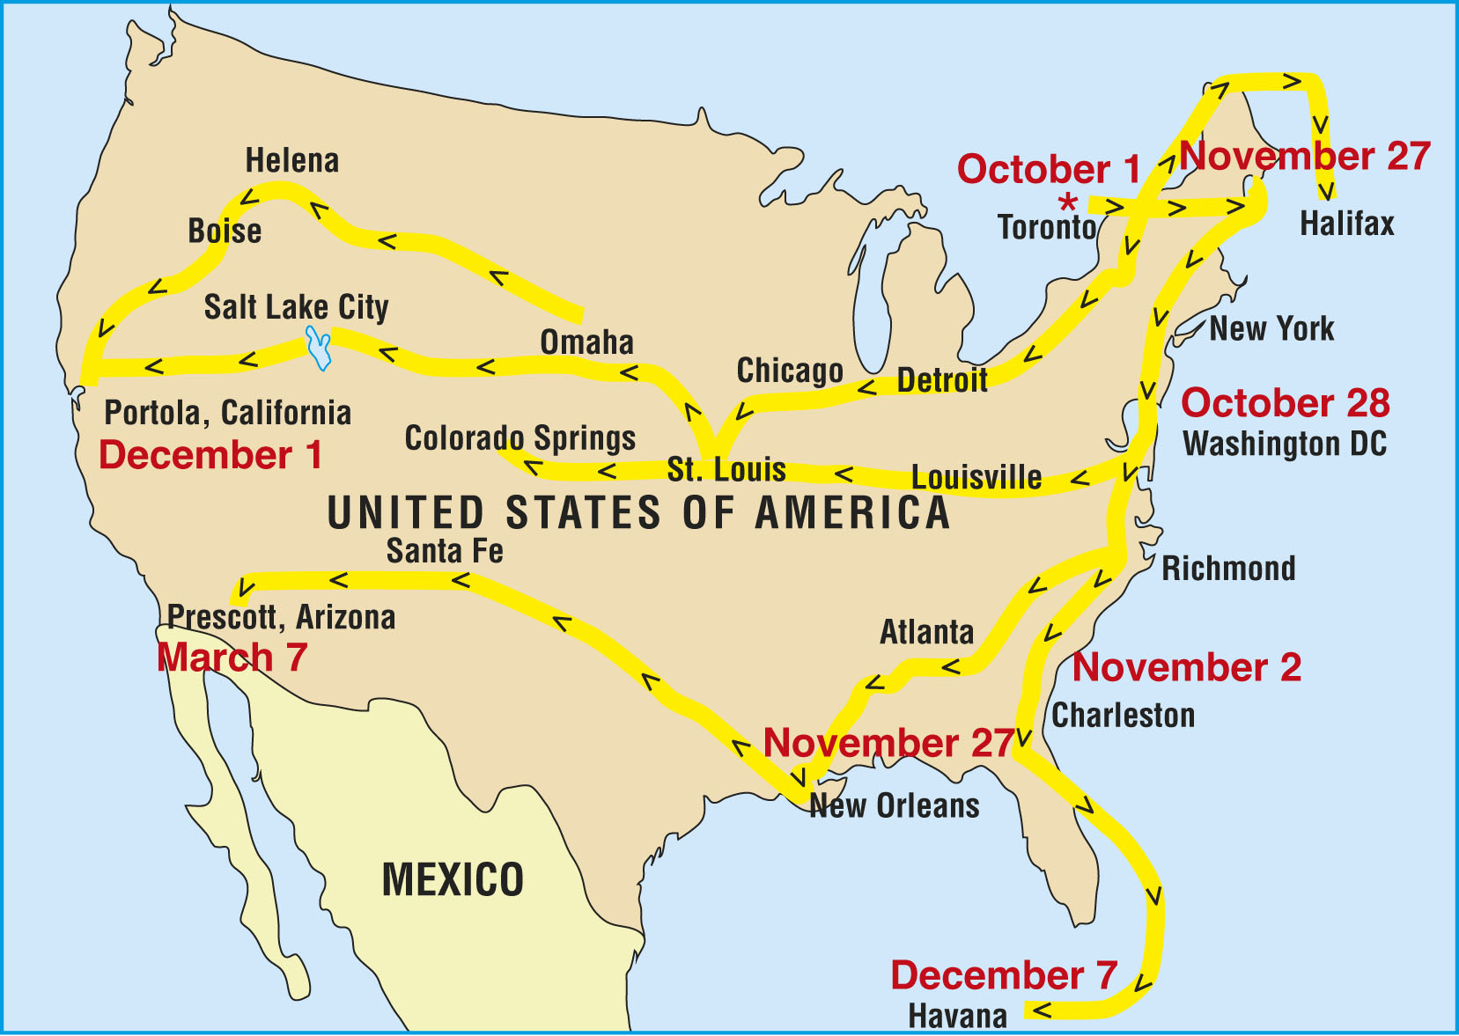
A highly contagious strain of equine influenza originated in Toronto, Canada, and swept south into the United States in late 1872, affecting the entire country within 90 days. Records show that 80–99 percent of all horses were eventually infected—unable to stand in their stables and coughing violently in the streets.
09/25 Markham, Ontario
10/01 Toronto, Ontario
10/10 Detroit, MI
10/14 Buffalo, NY
10/17 Rochester, NY
10/18 Montreal, Quebec
10/19 Syracuse, NY
10/21 Keene, NH
10/22 New York, NY
10/22 Boston, MA
10/23 Bangor, ME
10/23 Chicago, IL
10/24 Baltimore, MD
10/26 Pontiac, MI
10/28 Philadelphia, PA
10/28 Washington, DC
10/29 Columbus, OH
11/01 Newark, DE
11/02 Charleston, SC
11/04 Springfield, IL
11/05 Grand Rapids, MI
11/06 Richmond, VA
11/10 Indianapolis, IN
11/10 Savannah, GA
11/13 Louisville, KY
11/27 New Orleans, LA
12/01 Colorado Springs, CO
12/07 Havana, Cuba
01/26 Albuquerque, NM

Slide 6
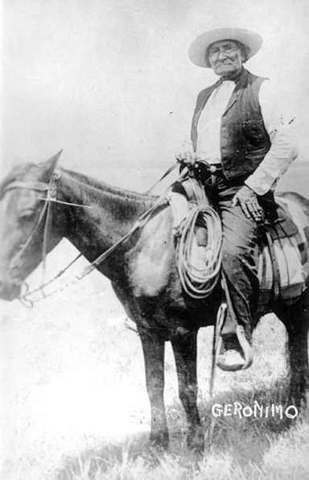
America Came to a Standstill
The government in Washington, D.C., was shut down.
Ships in New York harbor could not unload their cargo.
A small fire in Boston grew
into a devastating inferno, destroying a large amount of the city.
The U.S. Cavalry was forced to fight the Apaches on foot.

Slide 7
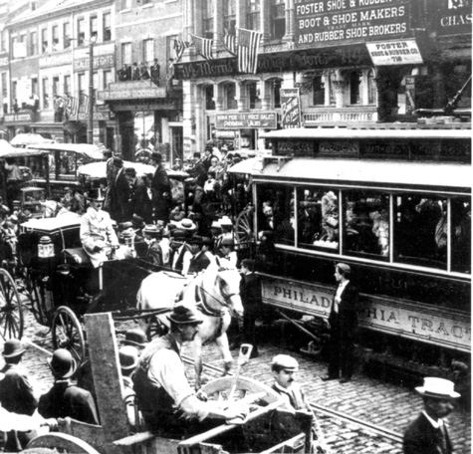
Everyday Life Was Frozen
In Philadelphia:
Streetcars were idled.
Freight remained at wharves and railroad depots.
Supplies of milk, ice, and groceries disappeared quickly.
Saloons no longer offered beer.
Work halted at construction sites without lumber and brick deliveries.
Fires burned unattended and garbage piled up on the curb.

Slide 8
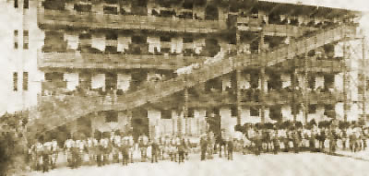
Isolating the Sick Was Ineffective
While the mortality rate was relatively low, estimated at about
2 percent overall, large cities lost many more horses than rural areas.
Because there were no horses to haul coal out of mines, railroads and thousands of other businesses went bankrupt.
A four-story horse hotel was used to quarantine the animals, to no avail. Philadelphia lost 2,500 horses. Of the 600,000 horses in the state of New York, more than 90 percent fell ill.

Slide 9
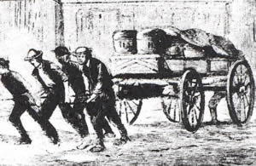
Newspapers Report Desperation
A New York Times article, October 24, 1872, gives a glimpse of the extent of the outbreak:
“There is hardly a public stable in the city which is not affected.”
“It is not uncommon along the streets of the city to see horses dragging along with drooping heads and at intervals coughing violently.”
“Large quantities of freight are accumulating along the Erie Railway in Paterson, New Jersey.”
“The disease is spreading rapidly in Bangor, Maine. All fire department horses in Providence, Rhode Island, are sick.”

Slide 10
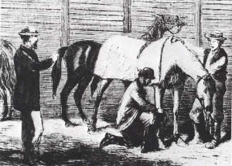
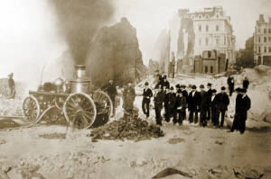
The Fate of the Economy Was in Jeopardy
It was becoming apparent that a nation so heavily dependent on the horse for so much could suffer an economic calamity from this epidemic.
Remember, this disease began spreading in the fall of 1872.
What are most farmers doing in the fall of every year?
How do midwestern crops get to eastern cities?
What impact would this event have had on people’s ability to buy food for their families?

Slide 11
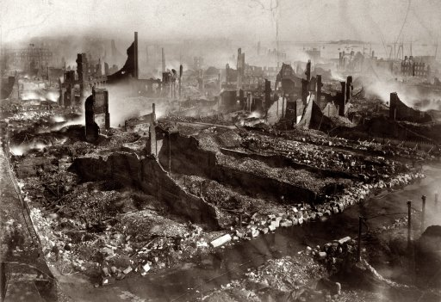
Great Boston Fire of 1872 Consumes Horseless Industrial Area
The story of this fire is
still recounted in Boston,
but few realize the
blaze’s magnitude was a consequence of the Great Epizootic. On November 9, fire swept quickly through the industrial section of
the city, ultimately killing
20 people and destroying
65 acres on which
776 buildings burned.

Slide 12
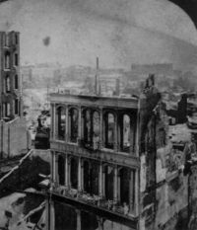
Firemen Strapped Harnesses to Themselves to Haul Water
No one is certain how the fire started. The water supply was inadequate, and many buildings had wooden roofs and were filled with flammable materials. Citizens of Boston were forced to haul water to the location on foot, without the assistance of powerful, faster-moving horses.

